Slide 1


Laplacian Matrices of Graphs:
Algorithms and Applications
Daniel A. Spielman
ICML, June 21, 2016

Slide 2
Outline
Laplacians
Interpolation on graphs
Spring networks
Clustering
Isotonic regression
Sparsification
Solving Laplacian Equations
Best results
The simplest algorithm

Slide 3
Interpolation on Graphs
(Zhu,Ghahramani,Lafferty ’03)
Interpolate values of a function at all vertices
from given values at a few vertices.
Minimize
Subject to given values
CDC20
ANAPC10
1
0
CDC27
ANAPC2
ANAPC5
UBE2C

Slide 4
Interpolation on Graphs
(Zhu,Ghahramani,Lafferty ’03)
Interpolate values of a function at all vertices
from given values at a few vertices.
Minimize
Subject to given values
0.51
CDC20
ANAPC10
1
0
CDC27
ANAPC2
0.53
0.30
ANAPC5
UBE2C
0.61

Slide 5
Interpolation on Graphs
(Zhu,Ghahramani,Lafferty ’03)
Interpolate values of a function at all vertices
from given values at a few vertices.
Minimize
Subject to given values
0.51
CDC20
ANAPC10
1
0
CDC27
ANAPC2
0.53
0.30
ANAPC5
UBE2C
0.61
Take derivatives. Minimize by solving Laplacian

Slide 6
Interpolation on Graphs
(Zhu,Ghahramani,Lafferty ’03)
Interpolate values of a function at all vertices
from given values at a few vertices.
Minimize
Subject to given values
0.51
CDC20
ANAPC10
1
0
CDC27
ANAPC2
0.53
0.30
ANAPC5
UBE2C
0.61
In the solution, variables are the average of their neighbors

Slide 7
The Laplacian Quadratic Form

Slide 8
The Laplacian Matrix of a Graph

Slide 9
Spring Networks
View edges as rubber bands or ideal linear springs
Nail down some vertices, let rest settle
In equilibrium, nodes are averages of neighbors.

Slide 10
Spring Networks
View edges as rubber bands or ideal linear springs
Nail down some vertices, let rest settle
When stretched to length
potential energy is

Slide 11
Spring Networks
Nail down some vertices, let rest settle
Physics: position minimizes total potential energy
subject to boundary constraints (nails)

Slide 12
Spring Networks
Interpolate values of a function at all vertices
from given values at a few vertices.
Minimize
CDC20
ANAPC10
1
0
CDC27
ANAPC2
ANAPC5
UBE2C

Slide 13
Spring Networks
Interpolate values of a function at all vertices
from given values at a few vertices.
Minimize
CDC20
ANAPC10
1
CDC27
ANAPC2
0
ANAPC5
UBE2C

Slide 14
Spring Networks
Interpolate values of a function at all vertices
from given values at a few vertices.
Minimize
0.51
CDC20
ANAPC10
1
CDC27
ANAPC2
0.53
0
ANAPC5
UBE2C
0.30
0.61
In equilibrium, nodes are averages of neighbors.

Slide 15
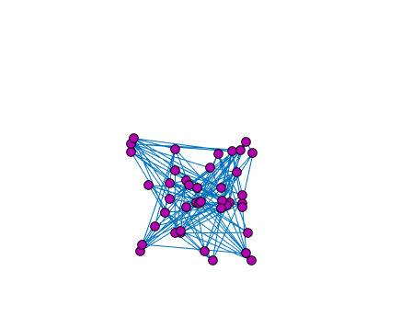
Drawing by Spring Networks
(Tutte ’63)
Notes:
socnetbad10

Slide 16
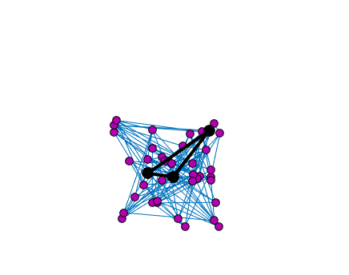
Drawing by Spring Networks
(Tutte ’63)
Notes:
socnetbad10

Slide 17
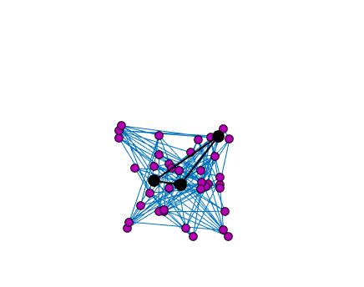
Drawing by Spring Networks
(Tutte ’63)
Notes:
socnetbad10

Slide 18
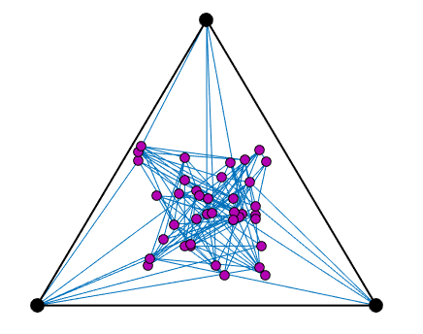
Drawing by Spring Networks
(Tutte ’63)
Notes:
socnetbad10

Slide 19
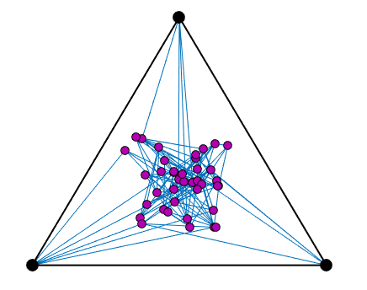
Drawing by Spring Networks
(Tutte ’63)
Notes:
socnetbad10

Slide 20
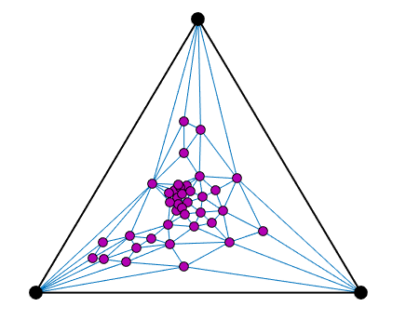
Drawing by Spring Networks
(Tutte ’63)
If the graph is planar,
then the spring drawing
has no crossing edges!
Notes:
socnetbad10

Slide 21
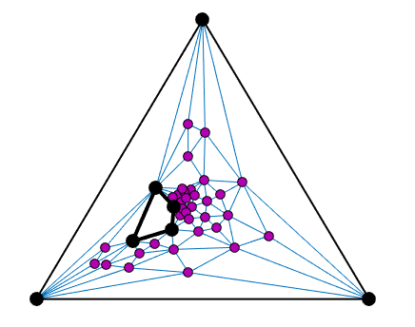
Drawing by Spring Networks
(Tutte ’63)
Notes:
socnetbad10

Slide 22
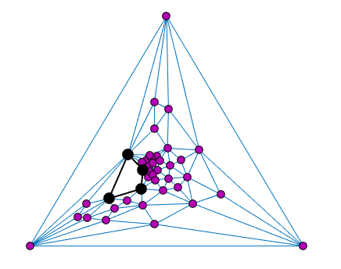
Drawing by Spring Networks
(Tutte ’63)
Notes:
socnetbad10

Slide 23
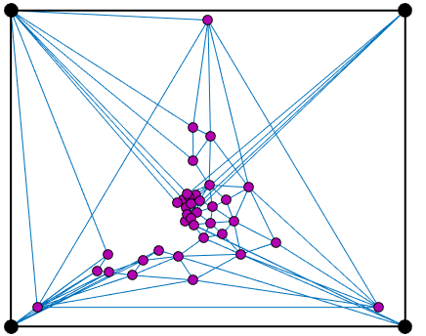
Drawing by Spring Networks
(Tutte ’63)
Notes:
socnetbad10

Slide 24
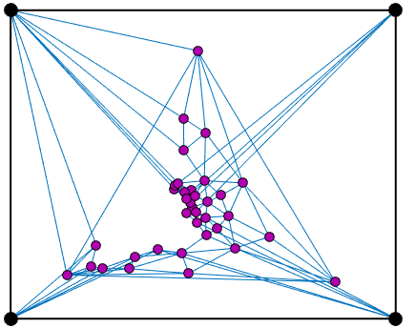
Drawing by Spring Networks
(Tutte ’63)
Notes:
socnetbad10

Slide 25
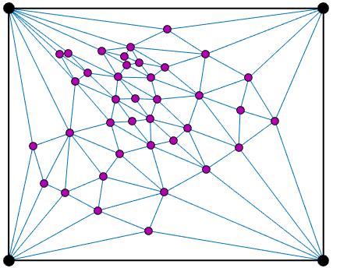
Drawing by Spring Networks
(Tutte ’63)
Notes:
socnetbad10

Slide 26
Measuring boundaries of sets
Boundary: edges leaving a set
S
S

Slide 27
Measuring boundaries of sets
Boundary: edges leaving a set
Characteristic Vector of S:
0
0
0
0
0
0
1
0
1
1
0
1
1
1
S
S
1
1
0
0

Slide 28
Measuring boundaries of sets
Boundary: edges leaving a set
Characteristic Vector of S:
0
0
0
0
0
0
1
0
1
1
0
1
1
1
S
S
1
1
0
0

Slide 29
Spectral Clustering and Partitioning
Find large sets of small boundary
Heuristic to find
x with small
Compute eigenvector
Consider the level sets
-0.4
0.7
0.2
-1.1
0.5
1.3
-0.20
1.6
0.9
0.4
1.3
1.0
0.8
S
S
1.1
0.8
0.5
-0.3

Slide 30
The Laplacian Matrix of a Graph
2
6
1
4
3
5
Symmetric
Non-positive
off-diagonals
Diagonally dominant

Slide 31
The Laplacian Matrix of a Graph

Slide 32
Laplacian Matrices of Weighted Graphs
where

Slide 33
Laplacian Matrices of Weighted Graphs
where
B is the signed edge-vertex adjacency matrix
with one row for each
W is the diagonal matrix of weights

Slide 34
Laplacian Matrices of Weighted Graphs
2
6
1
4
3
5

Slide 35
Quickly Solving Laplacian Equations
S,Teng ’04: Using low-stretch trees and sparsifiers
Where m is number of non-zeros and n is dimension

Slide 36
Quickly Solving Laplacian Equations
S,Teng ’04: Using low-stretch trees and sparsifiers
Koutis, Miller, Peng ’11: Low-stretch trees and sampling
Where m is number of non-zeros and n is dimension

Slide 37
Quickly Solving Laplacian Equations
S,Teng ’04: Using low-stretch trees and sparsifiers
Koutis, Miller, Peng ’11: Low-stretch trees and sampling
Cohen, Kyng, Pachocki, Peng, Rao ’14:
Where m is number of non-zeros and n is dimension

Slide 38
Quickly Solving Laplacian Equations
S,Teng ’04: Using low-stretch trees and sparsifiers
Koutis, Miller, Peng ’11: Low-stretch trees and sampling
Cohen, Kyng, Pachocki, Peng, Rao ’14:
Good code:
LAMG (lean algebraic multigrid) – Livne-Brandt
CMG (combinatorial multigrid) – Koutis

Slide 39
Quickly Solving Laplacian Equations
S,Teng ’04: Using low-stretch trees and sparsifiers
An -accurate solution to
is an x satisfying
where
Where m is number of non-zeros and n is dimension

Slide 40
Quickly Solving Laplacian Equations
S,Teng ’04: Using low-stretch trees and sparsifiers
An -accurate solution to
is an x satisfying
Allows fast computation of eigenvectors
corresponding to small eigenvalues.

Slide 41
Laplacians in Linear Programming
Laplacians appear when solving Linear Programs on
on graphs by Interior Point Methods
Maximum and Min-Cost Flow (Daitch, S ’08, Mądry ‘13)
Shortest Paths (Cohen, Mądry, Sankowski, Vladu ‘16)
Lipschitz Learning : regularized interpolation on graphs
(Kyng, Rao, Sachdeva,S ‘15)
Isotonic Regression (Kyng, Rao, Sachdeva ‘15)

Slide 42
Isotonic Regression
(Ayer et. al. ‘55)
3.7
3.6
4.0
3.2
3.9
3.2
2.5
A function is isotonic with respect to a
directed acyclic graph if x increases on edges.

Slide 43
Isotonic Regression
(Ayer et. al. ‘55)
College GPA
3.7
3.6
SAT
4.0
3.2
3.9
3.2
2.5
High-school GPA

Slide 44
Isotonic Regression
(Ayer et. al. ‘55)
College GPA
3.7
3.6
Estimate by
nearest neighbor?
SAT
4.0
3.2
3.9
3.2
2.5
High-school GPA

Slide 45
Isotonic Regression
(Ayer et. al. ‘55)
College GPA
3.7
3.6
Estimate by
nearest neighbor?
SAT
4.0
3.2
3.9
3.2
2.5
High-school GPA
We want the estimate to be monotonically increasing

Slide 46
Isotonic Regression
(Ayer et. al. ‘55)
College GPA
3.7
3.6
SAT
4.0
3.2
3.9
3.2
2.5
High-school GPA
Given find the isotonic x minimizing

Slide 47
Isotonic Regression
(Ayer et. al. ‘55)
College GPA
3.866
3.6
SAT
3.866
3.2
3.866
3.2
2.5
High-school GPA
Given find the isotonic x minimizing

Slide 48
Fast IPM for Isotonic Regression
(Kyng, Rao, Sachdeva ’15)
Given find the isotonic x minimizing

Slide 49
Fast IPM for Isotonic Regression
(Kyng, Rao, Sachdeva ’15)
Given find the isotonic x minimizing
or for any
in time

Slide 50
Linear Program for Isotonic Regression
Signed edge-vertex incidence matrix
x is isotonic if

Slide 51
Linear Program for Isotonic Regression
Given y, minimize
subject to

Slide 52
Linear Program for Isotonic Regression
Given y, minimize
subject to

Slide 53
Linear Program for Isotonic Regression
Given y, minimize
subject to

Slide 54
Linear Program for Isotonic Regression
Given y, minimize
subject to

Slide 55
Linear Program for Isotonic Regression
Minimize
subject to

Slide 56
Linear Program for Isotonic Regression
Minimize
subject to
IPM solves a sequence of equations of form
with positive diagonal matrices

Slide 57
Linear Program for Isotonic Regression
Laplacian!
are positive diagonal

Slide 58
Linear Program for Isotonic Regression
Laplacian!
are positive diagonal
Kyng, Rao, Sachdeva’15:
Reduce to solving Laplacians to constant accuracy

Slide 59
Spectral Sparsification
Every graph can be approximated
by a sparse graph with a similar Laplacian

Slide 60
Approximating Graphs
A graph H is an -approximation of G if
for all x

Slide 61
Approximating Graphs
A graph H is an -approximation of G if
for all x
That is,
Where iff

Slide 62
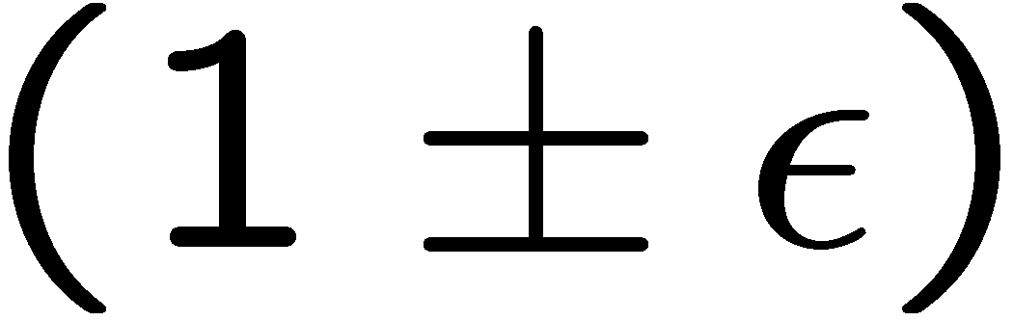
Approximating Graphs
A graph H is an -approximation of G if
for all x
Preserves boundaries of every set

Slide 63
Approximating Graphs
A graph H is an -approximation of G if
for all x
Solutions to linear equations are similiar

Slide 64
Spectral Sparsification
(Batson, S, Srivastava ’09)
Every graph G has an -approximation H
with edges

Slide 65
Spectral Sparsification
(Batson, S, Srivastava ’09)
Every graph G has an -approximation H
with edges
Random regular graphs approximate complete graphs

Slide 66
Fast Spectral Sparsification
(S & Srivastava ‘08)
If sample each edge with probability
inversely proportional to its effective spring constant,
only need samples
(Lee & Sun ‘15)
Can find an -approximation with edges in
time for every

Slide 67
Approximate Gaussian Elimination
(Kyng & Sachdeva ‘16)
Gaussian Elimination:
compute upper triangular U so that
Approximate Gaussian Elimination:
compute sparse upper triangular U so that

Slide 68
Gaussian Elimination
1. Find the rank-1 matrix that agrees
on the first row and column
2. Subtract it

Slide 69
Gaussian Elimination
1. Find the rank-1 matrix that agrees
on the first row and column
2. Subtract it
3. Repeat

Slide 70
Gaussian Elimination
2. Subtract it
1. Find the rank-1 matrix that agrees
on the next row and column

Slide 71
Gaussian Elimination
1. Find the rank-1 matrix that agrees
on the next row and column
2. Subtract it

Slide 72
Gaussian Elimination

Slide 73
Gaussian Elimination

Slide 74
Gaussian Elimination

Slide 75
Gaussian Elimination
Computation time proportional to the
sum of the squares of the number of nonzeros
in these vectors

Slide 76
Gaussian Elimination of Laplacians
If this is a Laplacian, then so is this

Slide 77
Gaussian Elimination of Laplacians
If this is a Laplacian, then so is this
When eliminate a node, add a clique on its neighbors
4
2
5
2
5
1
2
4
1
4
2
4
2
8
3
6
3
6

Slide 78
Approximate Gaussian Elimination
(Kyng & Sachdeva ‘16)
1. when eliminate a node, add a clique on its neighbors
4
2
5
2
5
1
2
4
1
4
2
4
2
8
3
6
3
6
2. Sparsify that clique, without ever constructing it

Slide 79
Approximate Gaussian Elimination
(Kyng & Sachdeva ‘16)
When eliminate a node of degree d,
add d edges at random between its neighbors,
sampled with probability proportional to
the weight of the edge to the eliminated node
1

Slide 80
Approximate Gaussian Elimination
(Kyng & Sachdeva ‘16)
0. Initialize by randomly permuting vertices, and
making copies of every edge
When eliminate a node of degree d,
add d edges at random between its neighbors,
sampled with probability proportional to
the weight of the edge to the eliminated node
Total time is

Slide 81
Approximate Gaussian Elimination
(Kyng & Sachdeva ‘16)
Analysis by Random Matrix Theory:
Write U^{T}U as a sum of random matrices.
Random permutation and copying
control the variances of the random matrices
Apply Matrix Freedman inequality (Tropp ‘11)

Slide 82
Approximate Gaussian Elimination
(Kyng & Sachdeva ‘16)
0. Initialize by randomly permuting vertices, and
making copies of every edge
When eliminate a node of degree d,
add d edges at random between its neighbors,
sampled with probability proportional to
the weight of the edge to the eliminated node
Total time is
Can be improved by sacrificing some simplicity

Slide 83
Recent Developments
Other families of linear systems
complex-weighted Laplacians
connection Laplacians
Other optimization problems
(Kyng, Lee, Peng, Sachdeva, S ‘16)

Slide 84
To learn more
My web page on:
Laplacian linear equations, sparsification, local graph clustering, low-stretch spanning trees, and so on.
My class notes from
“Graphs and Networks” and “Spectral Graph Theory”
Lx = b, by Nisheeth Vishnoi
Laplacians.jl

